Slide 1
Memory Management
Part 3
Memory Management Strategies
Virtual Memory Management

Slide 2

Memory Allocation
Best fit:
Allocate the smallest hole that is big enough
Search the entire list unless sorted by size
Produces the smallest leftover hole
Worst fit:
Allocate the largest hole
Produces the largest leftover hole
Search the entire list unless it is sorted by size
Simulation results
First and best fit are better than worst fit in terms of decreasing time and storage utilization
First fit is generally faster than best fit

Slide 3
Memory Allocation
free holes process demand
1k 1k 5k
2k 2k 10k
8k 6k 4k
9k 8k
12k 9k Use first fit, best fit and
6k 12k worst fit for allocation
15k 15k
20k 20k

Slide 4
Fragmentation
Both first fit and best fit strategies suffer from external fragmentation
Free memory space is broken into small pieces
External fragmentation exists when there is enough total memory space to satisfy a request but the available spaces are not contiguous
Storage is fragmented into a large number of small holes
Depending on the total memory space and the average process size
External fragmentation may be a minor or major problem
First fit has been shown to suffer from the 50 percent rule

Slide 5
Fragmentation
4K
P1
6K
P4
2K
P8
P5

Slide 6
Fragmentation
50-percent rule
Given N allocated blocks, another 0.5 N blocks are lost to fragmentation
One-third of the memory may be unusable
Memory fragmentation can be either internal or external
Internal fragmentation
Memory is generally divided into fixed size blocks and allocated to processes in multiples of fixed size blocks
Allocated memory may be larger than the requested size
Difference results in unused memory lost to internal fragmentation
Notes:
Fixed size blocks are of 4k bytes each and total process requirement is of 10k bytes

Slide 7
Fragmentation
Compaction is a solution to external fragmentation
Shuffle free memory spaces to form one large contiguous block
Possible only if relocation is dynamic and is done at run time
Compaction algorithms
Another solution to external fragmentation
Permit the physical address space of the processes to be noncontiguous
The technique is used in paging
The most common memory management technique

Slide 8
Paging
A memory management scheme that permits the physical address space of a process to be noncontiguous
Avoids external fragmentation and the need for compaction
Most operating systems use paging
Basic Method
Physical memory is partitioned into fixed- sized blocks – frames
Logical memory is also partitioned into the same fixed-sized blocks – pages
When a process is to be executed
Pages are loaded from the backing store into the available memory frames
Backing store is also partitioned into fixed-sized blocks of the same size

Slide 9
Basic Method of Paging
Hardware support for paging
Every address is divided into two parts
Page number is used as an index into a per- process page table
Page table contains the base address of each frame in physical memory
The paging model of memory
Page size is defined by the hardware
Typically a power of 2
Varies between 512 bytes to 1GBbytes
If the size of logical address space is 2^{m} and page size is 2^{n}
The higher order (m – n) bits designate the page number
The lower n bits designate the page offset

Slide 10
Paging Hardware
Page number
Page Offset
p
d
Logical address is of m bits
Example:
4 Gbytes memory and 4 Kbytes page size
Number bits in address = 32, number of bits for page offset = 12
Notes:
10

Slide 11
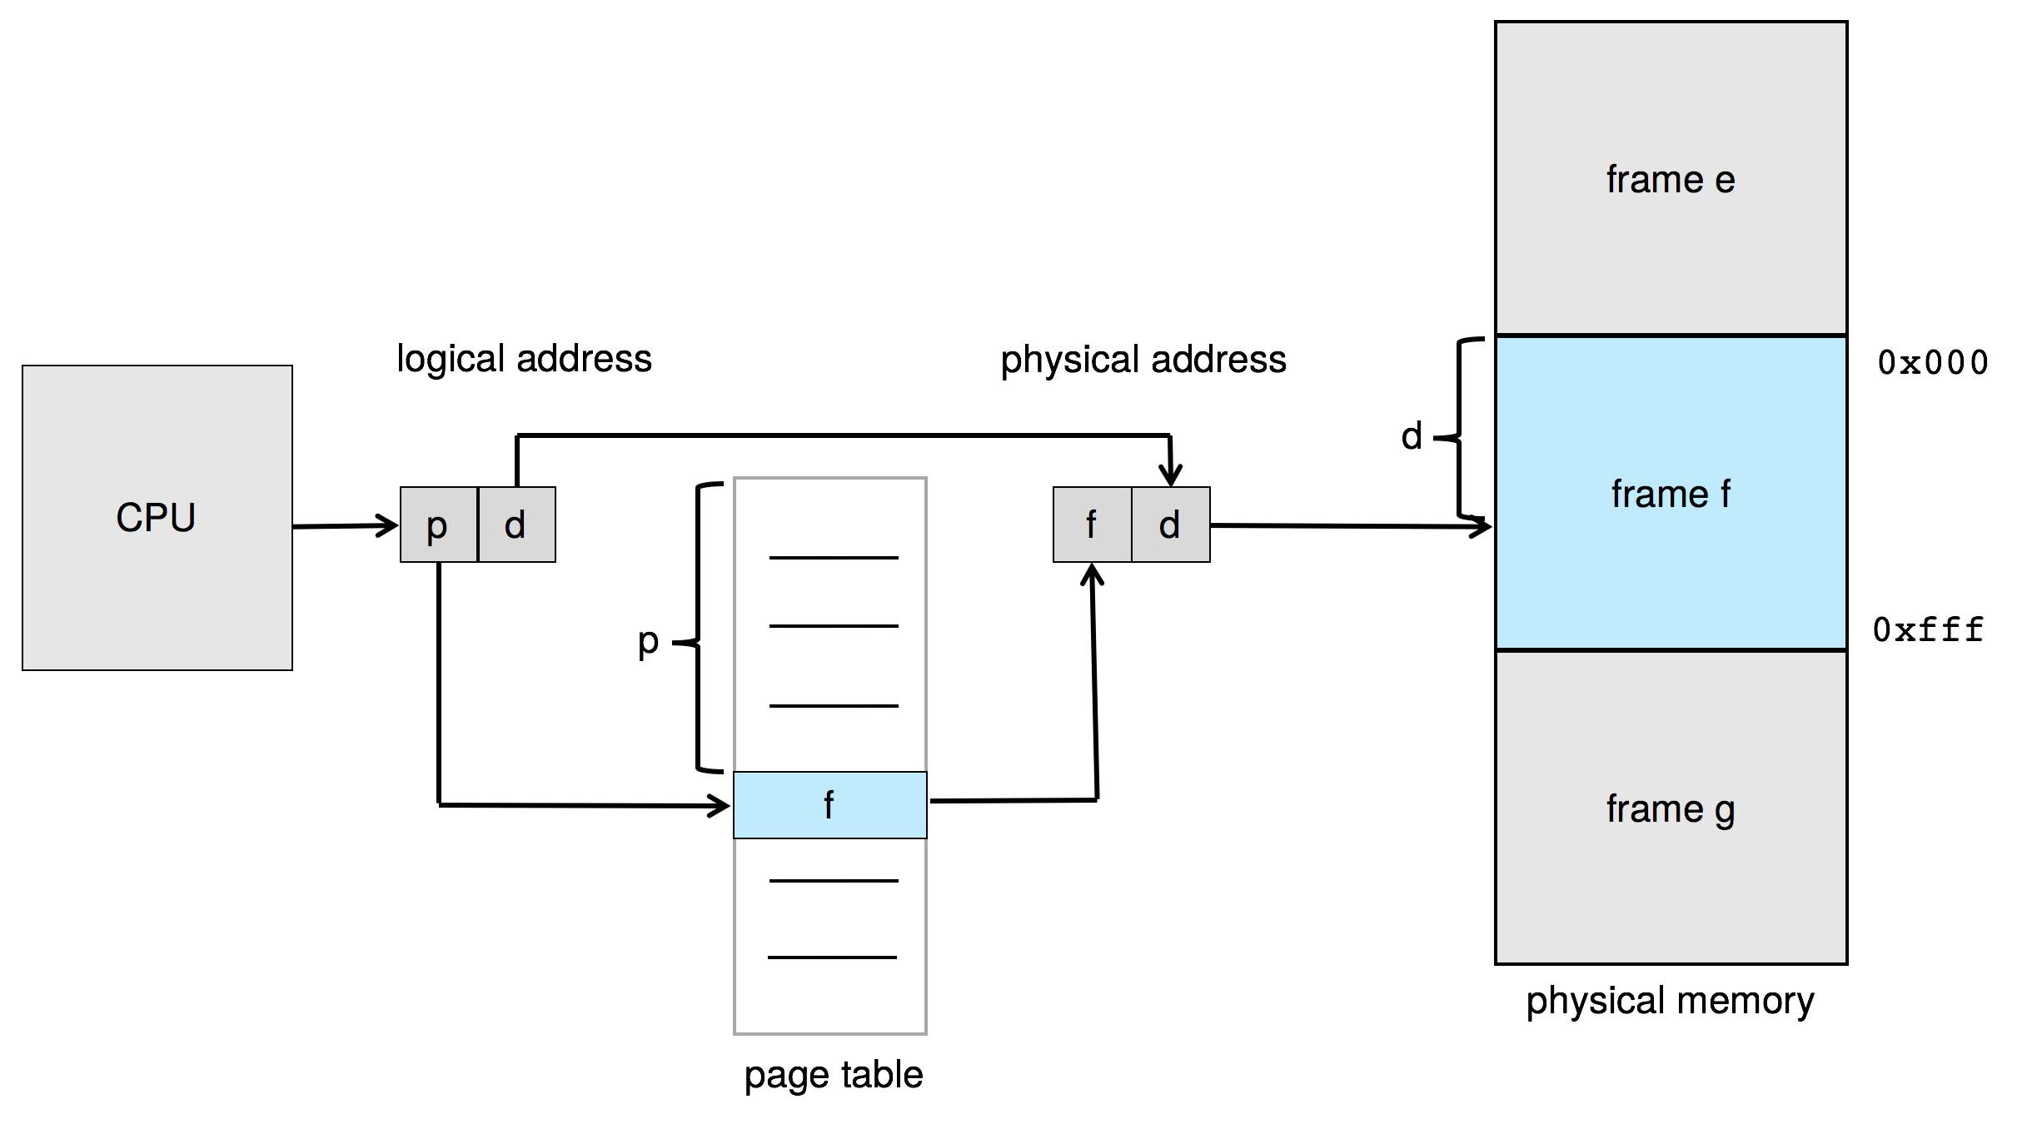
Paging Hardware
Notes:
11

Slide 12
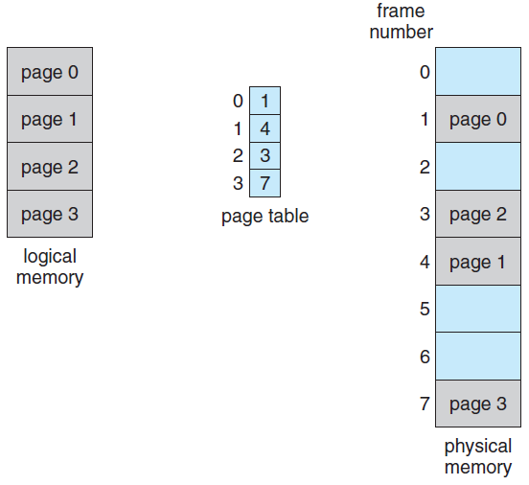
Paging Model of Logical and Physical Memory
m – n
n
Notes:
12

Slide 13
Basic Method of Paging
page number
page offset
p
d
m - n
n
p is the index to the page table and d is the displacement within the page
Paging is a form of dynamic relocation
There is no external fragmentation in paging
There may be internal fragmentation
Last allocated frame may not be completely full
Average internal fragmentation is half page per process
Small page sizes are desirable
Overhead of page table increases with small page sizes
Disk I/O is more efficient with large page sizes
Notes:
Process is of 10K and we have page size of 4 K each. Allocation will be of 12 K and 2k is lost to internal fragmentation

Slide 14
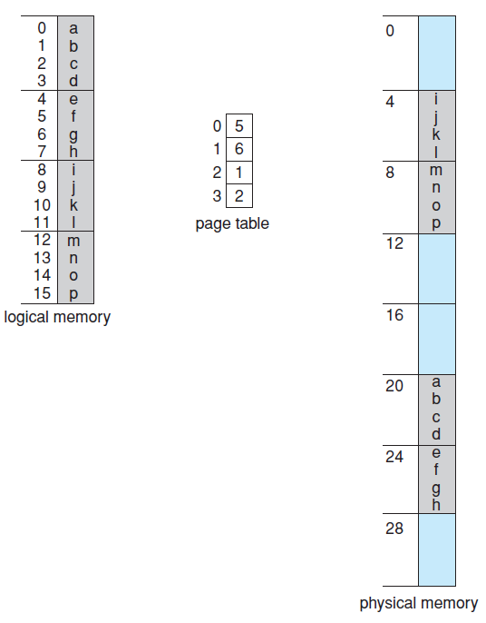
Paging Example
Here
m = 4 and n=2
Physical mem. = 32 bytes
32-byte memory and 4 byte pages
Logical addresses
0
3
4
Notes:
14

Slide 15
Paging example
Logical address 0
address in binary = 0000
page offset = 00
page number 00 maps to frame number 5
Physical address
20. how?
(5 x 4) + 0
Logical address 4
address in binary = 0100, page 1, offset 0
physical address = (6 x 4) + 0 = 24
Do the same for logical address 13

Slide 16
Basic Method of Paging
Page sizes have increased with the increase in processor performance
4KB and 8 KB sized pages
Some CPUs and kernels support multiple page sizes
Windows-10 supports 4Kb and 2MB on Intel x86-64 systems
Large pages are called huge or super pages
Each page table entry is 4 bytes long
Frames are allocated to processes as required
There is a clear separation between user’s view of memory and the actual physical memory
The difference between the two is reconciled by the address-translation hardware

Slide 17
Basic Method of Paging
Logical addresses are translated into physical addresses
Mapping is hidden from the user and is controlled by the OS
OS maintains a frame table of all frames that has one entry for each physical page frame
Both allocated and unallocated frames
It also maintains a copy of the page table for each process
This is used by the dispatcher to define the hardware page table when a process is to be allocated to the CPU
Paging increases the context-switching time

Slide 18
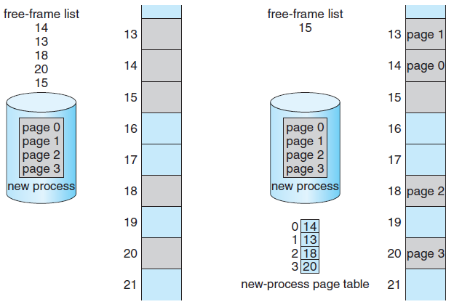
Free Frames before and after allocation
Before allocation
After allocation
Notes:
18

Slide 19
Hardware Support
OS allocates one page table for each process
Pointer to the page table is stored in the process control block of that process
Hardware implementation of page table
Simplest case
Page table is implemented as a set of dedicated registers
The registers should be built with high speed logic circuits to achieve fast address translation
These registers are reloaded by the dispatcher as a part of context-switch time
Feasible if the page table is reasonably small
Current generation computers support very large page tables

Slide 20
Hardware Support
Page table is kept in main memory
PTBR (Page Table Base Register) points to the page table of the process
Changing page table requires changing only the content of PTBR
Context switch time is reduced
Problem
Time required to access a memory location increases
Two memory accesses are required for every desired access to memory
Solution
Use a special, small, fast lookup hardware cache
Translation look-aside buffer (TLB)

Slide 21
Translation Lookaside Buffer
TLB
An associative, high-speed memory
Each entry of TLB consists of two parts
A key (or tag) and a value
The search process in the TLB
This is a fast operation but the hardware is expensive
Number of entries in the TLB is small
Typically between 64 and 1024 entries
Current generation processors have separate TLBs, one for instruction and one for data
There are multiple levels of TLB in many
Working of the TLB
TLB miss and TLB hit
In case of TLB miss, page table should be accessed

Slide 22
TLB Structure
A key (or tag)
Value
Logical page number
Physical frame number/address

Slide 23
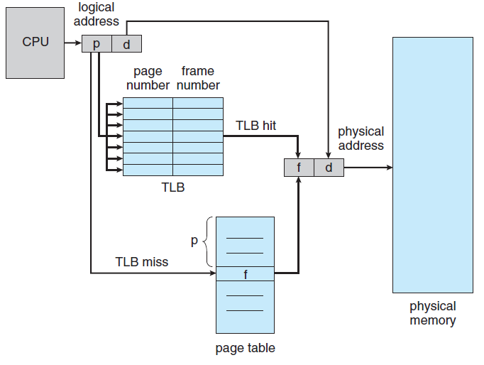
Paging Hardware With TLB
Notes:
23

Slide 24
Hardware Support
If the TLB is full, an entry should be selected for replacement
Replacement policies range from Least Recently Used (LRU) to random
Some TLBs allow entries to be wired down
These entries cannot be removed from the TLB
Major kernel code
Some TLBs store Address Space Identifiers (ASIDs) in each TLB entry
An ASID uniquely identifies each process and provides address-space protection for that process
Allows TLB to contain entries for several processes simultaneously
TLB must be flushed otherwise

